Slide 1

Capstone Project - 1
AIRBNB Analysis (EDA)
Team Members :-
Anish Gupta
Mayur Chavan
Sanjeev Kumar

Slide 2


Table Of Content
Introduction
Data Cleaning and Wrangling
Exploratory Data Analysis & Visualization
Conclusion

Slide 3
Introduction
Since 2008, guests and hosts have used Airbnb to expand on traveling possibilities and present a more unique, personalized way of experiencing the world. Today, Airbnb became one of a kind service that is used and recognized by the whole world. Data analysis on millions of listings provided through Airbnb is a crucial factor for the company. These millions of listings generate a lot of data - data that can be analyzed and used for security, business decisions, understanding of customers' and providers' (hosts) behavior and performance on the platform, guiding marketing initiatives, implementation of innovative additional services and much more.
This dataset has around 49,000 observations in it with 16 columns and it is a mix between categorical and numeric values.
Explore and analyze the data to discover key understandings

Slide 4
Understand The Variables
Variables
Variables
minimum_nights- It is the minimum nights for which booking should be done
Id - Unique id for every record
Name - Name of the host listing
host_id - Unique id given to the host
host_name - Name of the host(owner)
neighbourhood_group - It could be a city/location
neighbourhood - Particular area in respective neighbourhood group
latitde- Horizantal co-ordinates for respective host
longitude- Vertical co-ordinates for respective host
number_of_reviews- Total reviews given to the host
last_review- Last review given by a customer to the host.
reviews_per_month- It's average reviews given by customer to the host per month
calculated_host_listings_count- Total listing count of a particular host.
availability_365- Host available in a year given in number of days.
room_type - Type of room
price- Price charged by host

Slide 5
Exploratory Data Analysis Process: Exploratory Data Analysis (EDA) is an approach to analyzing and summarizing data sets to gain insights and understand the underlying patterns and relationships within the data. It is often one of the first steps in the data analysis process.
EDA
Importing Libraries
Loading Data
Understand Variables
Data Cleaning
Data Wrangling
Data Visualization

Slide 6




Graphs & Libraries
Graphs
Python Libraries
Line Chart
Bar Chart
Scatter plot
Heatmap
Pie Chart
NumPy
Pandas
Matplotlib
Seaborn

Slide 7
EDA On AIRBNB Dataset
Problem Statement
Top 5 host with maximum number of bookings
Number of bookings per Neighborhood group
Number of bookings per room type
Popular Neighborhood within Neighborhood group
Availability per neighborhood group
Availability per Neighborhood group and room type
Price vs neighborhood group
Room Type vs Price
Price vs Room Type for each Neighborhood Group
Relation between minimum night and room type
Relation between minimum night and room type for every Neighborhood group
Host with most listed properties
Airbnb Booking Locations by Neighborhood Group
Plot on Heat map

Slide 8
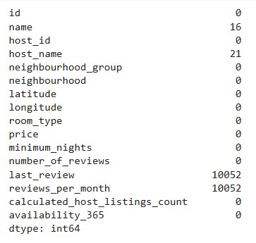
Data cleaning
Handling Null Values: As we can check the “last_review & reviews_per_month” having a high number of null values
followed by “name & host_name”
We filled "name","host_name","last_review“ with the value “Unknown”
And reviews_per_month with value “0”
Removing Duplicates: We checked the dataset but there were no duplicate data

Slide 9
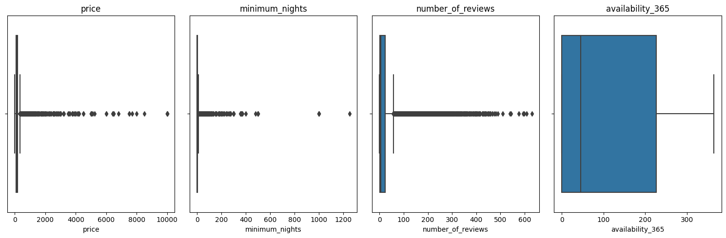
Outlier

Slide 10
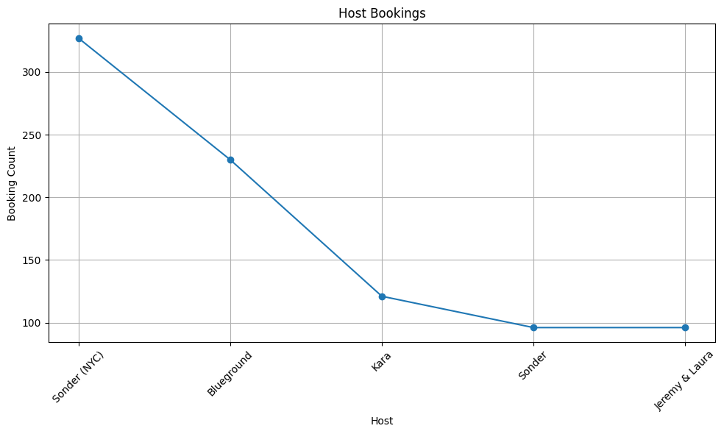
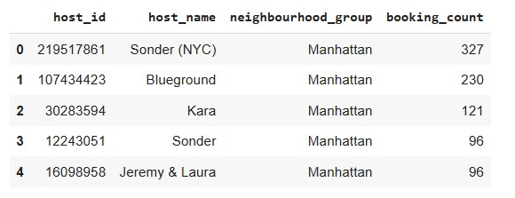
EDA:
1) Top 5 host with maximum number of bookings
We found the insight that Sonder(NYC) , Blueground , Kara , Sonder and Jeremy & Laura these are top 5 hosts who have maximum number of bookings with them.
So from this we can say that Sonder(NYC) earns maximum among all other hosts.

Slide 11
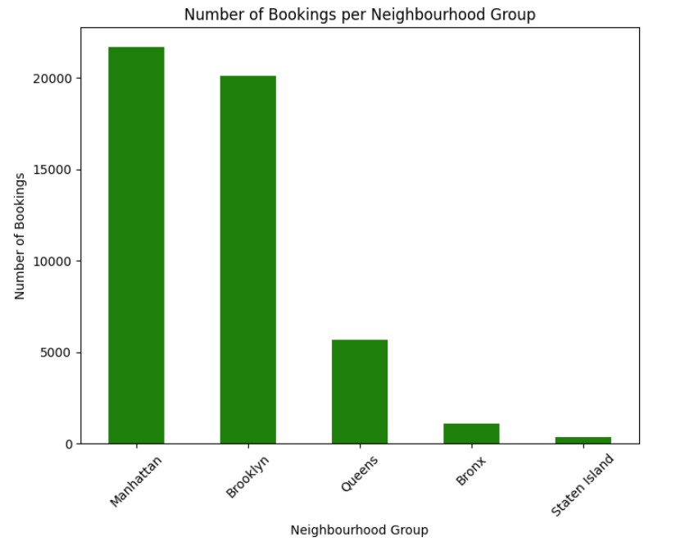
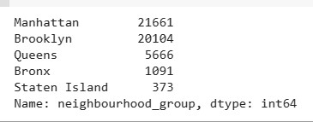
EDA:
2)Number of bookings per neighbourhood group
We can find the insight that Manhattan Neighbourhood group is having maximum number of bookings.
so we can also say that Manhattan is more busy Neighbourhood group among other Neighbourhood group.

Slide 12
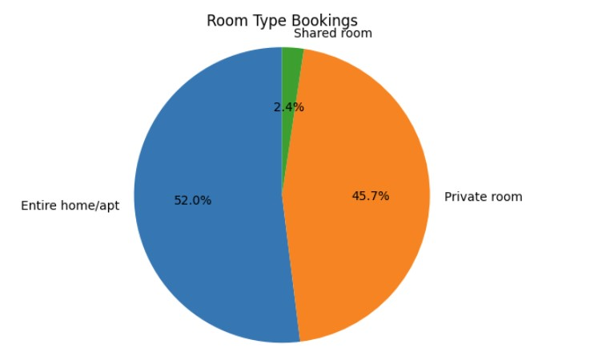

EDA:
3)Number of bookings per room type
We can find the insight that "Entire home/apt" is most preferred room type among customers & then after that "Private room" is preferred.

Slide 13
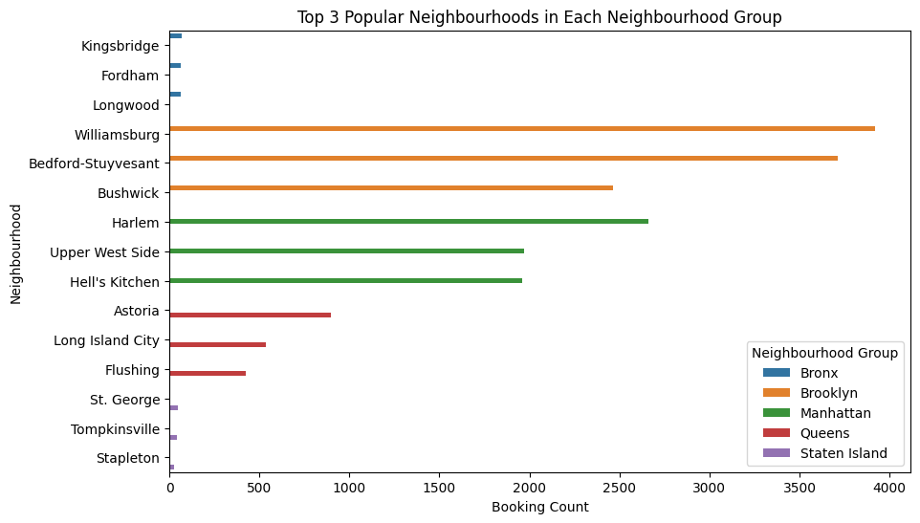
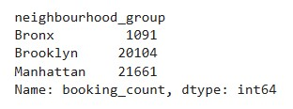
EDA:
4)Popular neighborhoods within neighbourhood group
From the above we can found that Neighborhoods Kingsbridge , Williamsburg , Harlem , Astoria & St.George having max bookings as compare to other Neighborhoods in that Neighbourhood group simultaneously Bronx , Brooklyn , Manhattan , Queens , & Staten Island

Slide 14
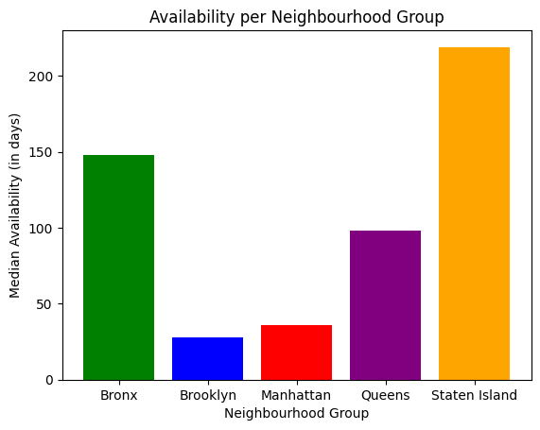
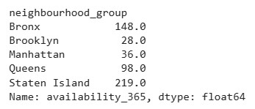
EDA:
5)Availability per neighborhood group
From this we can find that Staten Island have the high availability and Brooklyn having low availability for booking when compared with others

Slide 15
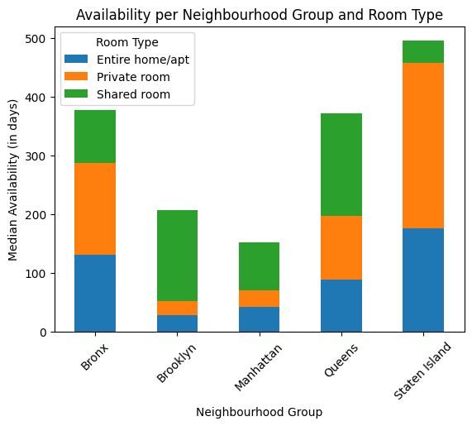
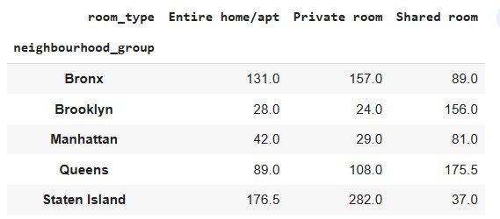
EDA:
6)Availability per neighbourhood group and room type
We can find the insight that in "Staten Island" availability is more as compare to others & in that also the "Private Room" is available maximum.
Hosts earns more from Private Room comparatively other room types.

Slide 16
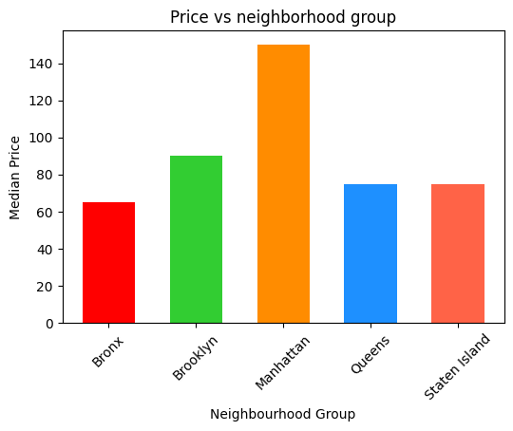
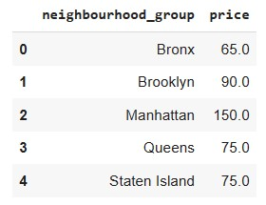
EDA:
7)Price vs neighborhood group
We can find insight that in "Manhattan" having highest price as compare to other Neighbourhood Groups.
In "Manhattan" the prices are high so we can say there will be maximum profit in minimum number of bookings.

Slide 17
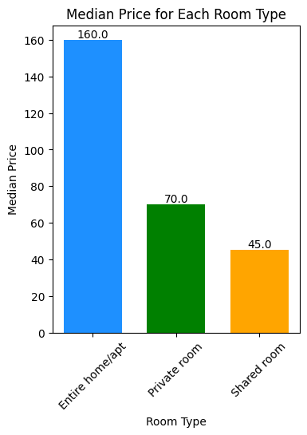
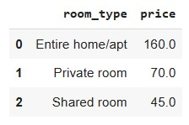
EDA:
8)Room Type vs Price
The insight we can find is that "Entire home/apt" price is highest as compare to other room types.

Slide 18
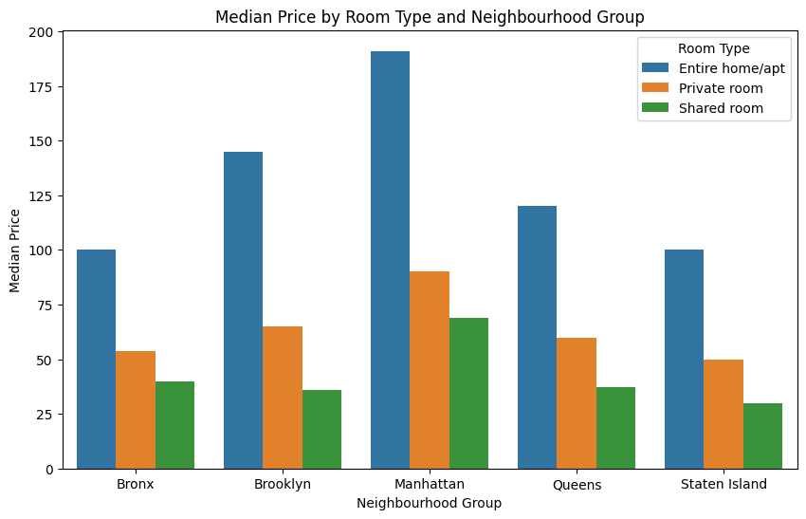
EDA:
9)Price vs Room Type for each Neighbourhood Group
We can find insight that "Manhattan's" booking price is higher than any other neighbourhood groups in terms of all room types.
The host who is having properties in "Manhattan" more , that host can earn maximum as compare to other hosts.

Slide 19
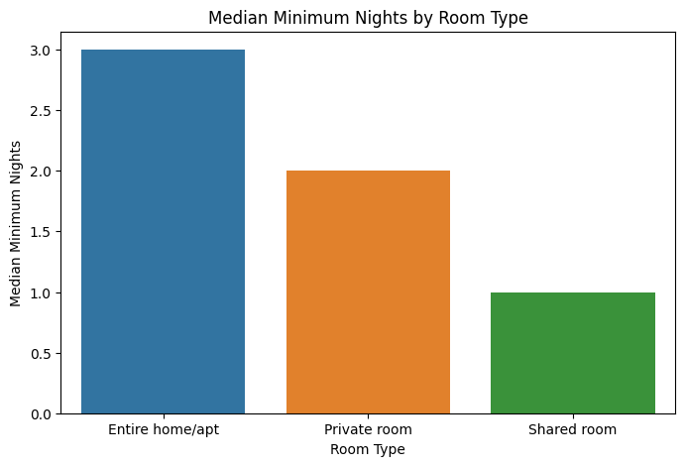
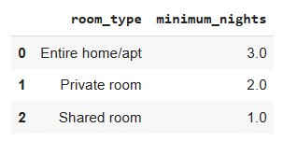
EDA:
10)Relation between minimum night and room type
We can find the insight that if someone wants to book "Entire home/apt" then minimum nights booking is highest as compare to other room types.

Slide 20
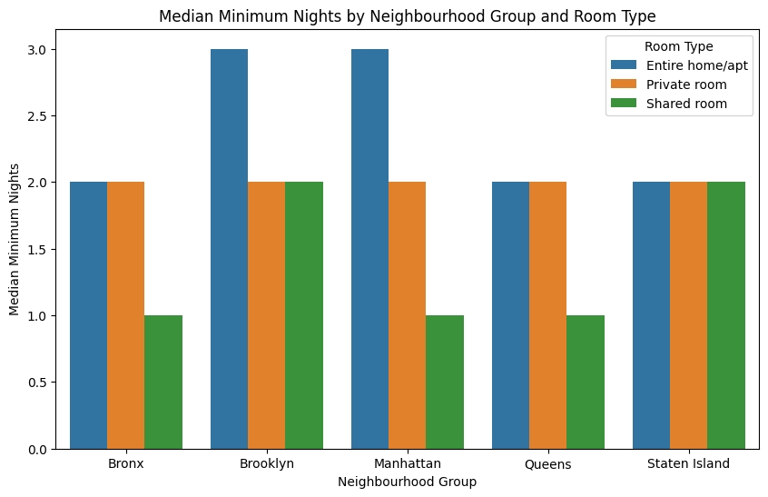
EDA:
11)Relation between minimum night and room type for every neighbourhood group
We can find insight that in "Manhattan's" booking minimum nights is higher than any other neighbourhood groups in terms of all room types.
The host who is having properties in "Manhattan" more , that host can earn maximum as compare to other hosts.

Slide 21
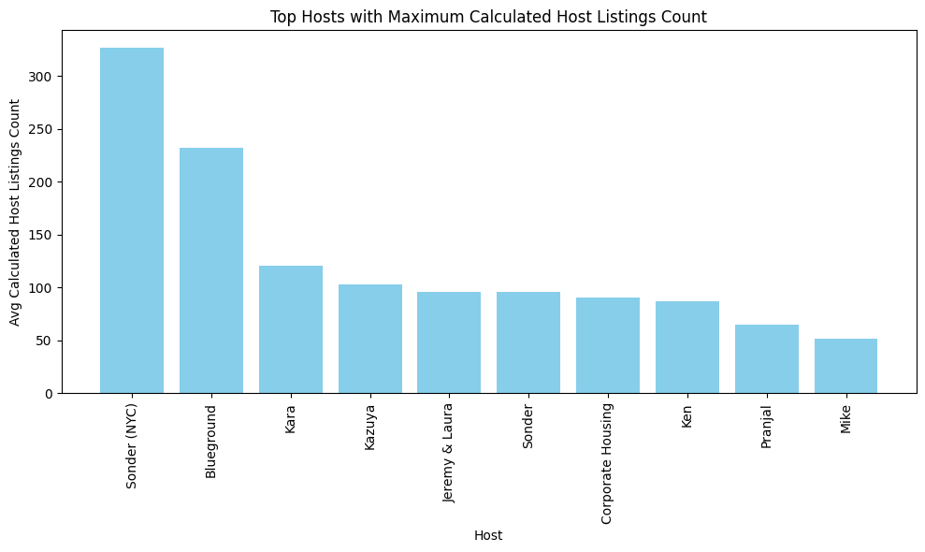
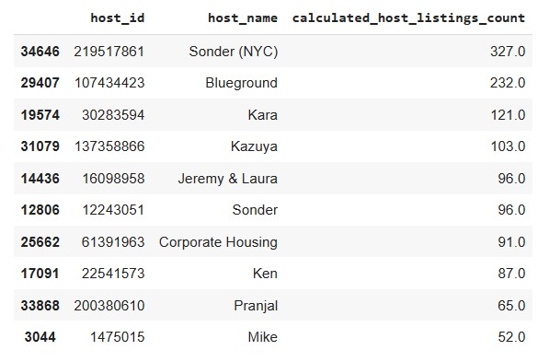
EDA:
We found insight that Sonder(NYC) having highest and Mike having lowest number of listed properties.
12)Host with most listed properties

Slide 22
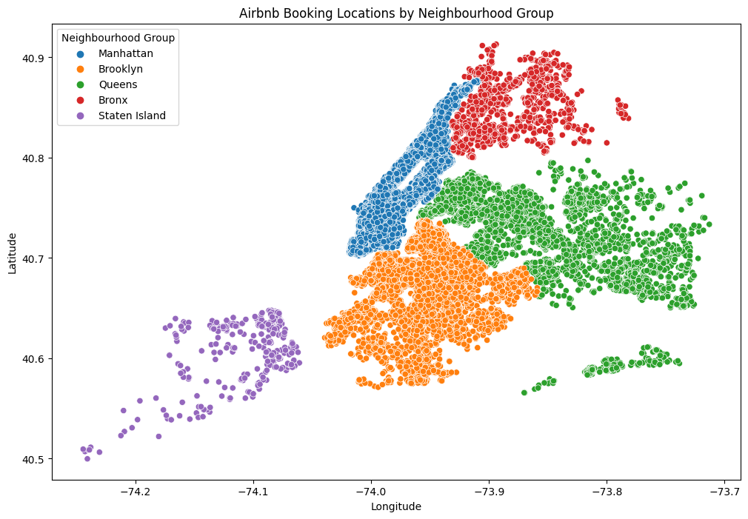
EDA:
13)Airbnb Booking Locations by Neighbourhood Group
From this graph we get the exact location with number of booking in particular location.

Slide 23
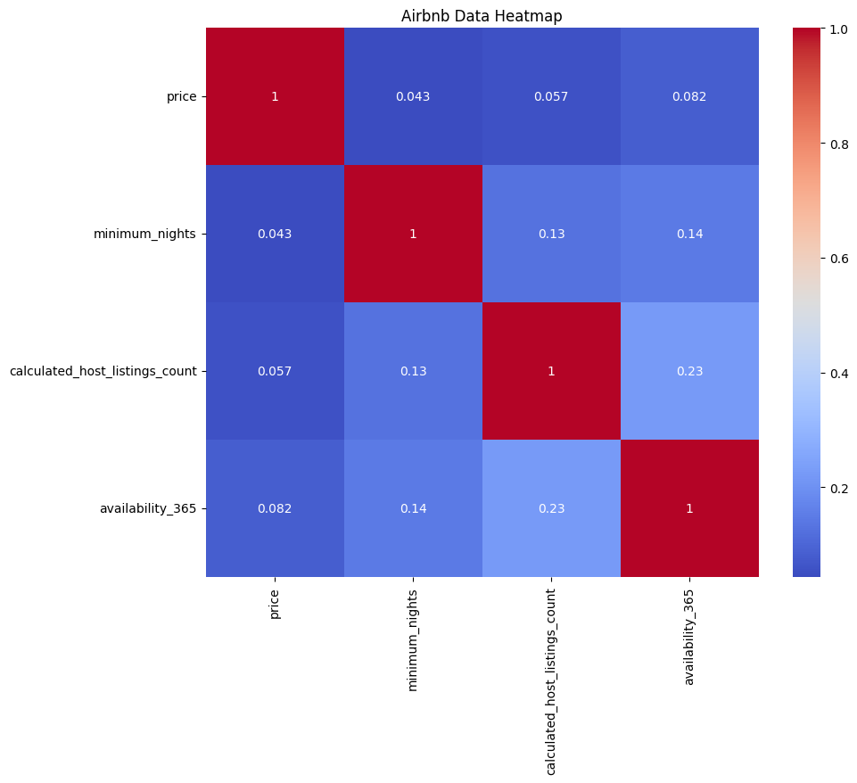
EDA:
14)Plot on Heat map
Heatmaps are widely used for visualizing and analyzing data, particularly in situations where there is a need to understand patterns, relationships, or variations across multiple variables

Slide 24
Solution to Business Objective
Based on the insights derived from the Airbnb dataset, I would suggest the client focus on the following business objectives:
Enhance the Host Experience: Identify the top five hosts with the maximum number of bookings. Collaborate with these hosts to understand their strategies for success and implement best practices across the platform. This will help attract more hosts and improve the overall experience for both hosts and guests.
Improve Marketing and Targeting: Utilize the information on the number of bookings per neighbourhood group to optimize marketing efforts. By understanding which neighbourhood groups are more popular, the client can allocate resources effectively to attract more guests and hosts in those areas.
Optimize Pricing Strategy: Analyze the price variations across different neighbourhood groups and room types. This will enable the client to identify opportunities to adjust pricing strategies and potentially increase revenue. Additionally, understanding the relationship between room type and price can help in setting competitive rates.
Enhance Guest Experience: Identify popular neighbourhoods within each neighbourhood group. By focusing on these areas, the client can ensure a wider range of listings and amenities, making the guest experience more enjoyable and diverse.
Improve Availability Management: Analyze availability per neighbourhood group and room type. This information can be used to balance supply and demand, optimize occupancy rates, and reduce instances of unavailability for guests.
Encourage Long-term Bookings: Explore the relationship between minimum nights and room type. By understanding this relationship, the client can incentivize longer bookings and tailor promotional offers accordingly.
Nurture High-Performing Hosts: Identify hosts with the most listed properties. These hosts can be valuable assets to the platform. Building a strong relationship with them, providing support and incentives, can help maintain their loyalty and encourage them to expand their listings.
Tailor Marketing Campaigns: Leverage the insights from Airbnb booking locations by neighbourhood group. This information can be used to target specific areas and create personalized marketing campaigns, attracting more guests to those locations.

Slide 25
Conclusion
In conclusion, through this Python EDA project on the Airbnb dataset, we have gained valuable insights into the booking trends, host performance, pricing dynamics, and availability patterns. By leveraging these insights, the client can make informed business decisions to enhance the host and guest experience, optimize marketing efforts, improve availability management, and drive revenue growth. It is crucial for the client to continuously monitor and analyze the data to adapt to changing market dynamics and ensure ongoing success in the competitive Airbnb ecosystem.

